Slide 1
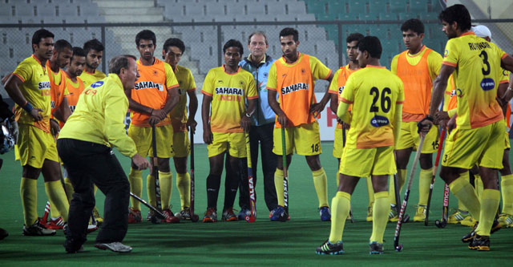
They carry so many habits from junior Program, It’s tough to win against the top international teams.
Notes:
Terry Walsh, Asian games

Slide 2
UPSC-2015
How to kick start GS preparation
Newspapers, Notes making
Time management, Career backup

Slide 3
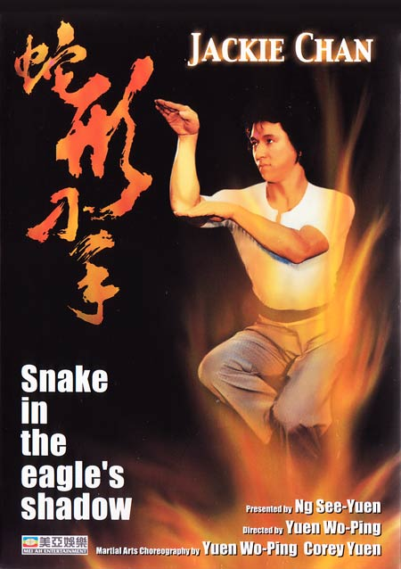
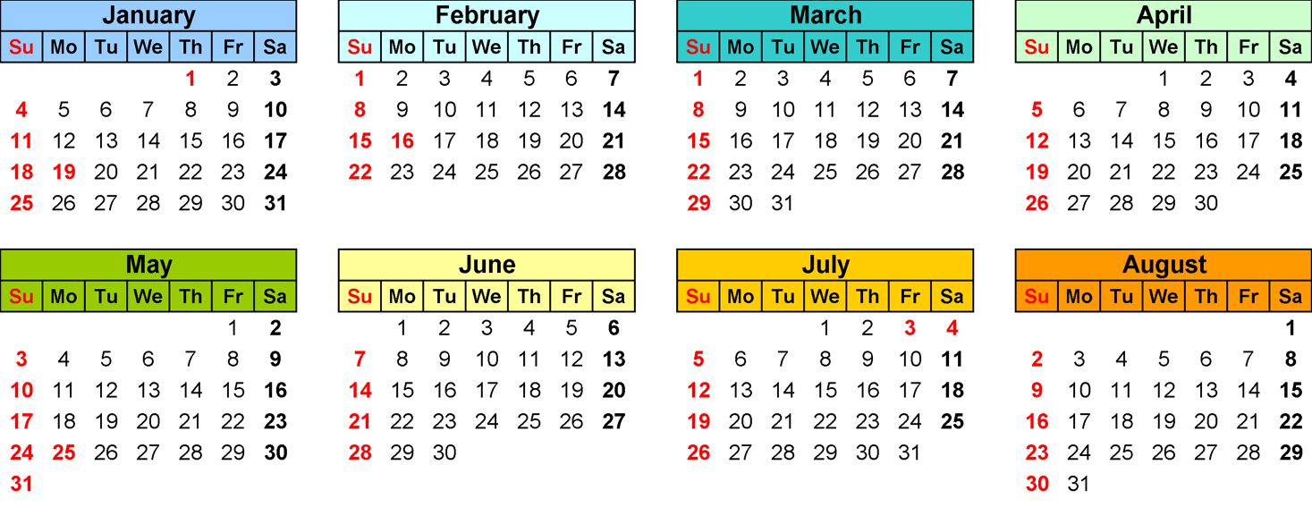
Qatal ki Subh
~200 days
“GS-Core Syllabus”
Optional Syllabus
Earlier failures:
Far away=>from scratch
Closer=>mocks+GSM+Optional+Backup exams

Slide 4
7/8 Pillars @MCQ stage
Polity
Economy
History
Geography and Agriculture
Environment & Biodiversity
Science
International Relation
PIN, Awards, Sports (Hardly in UPSC)

Slide 5
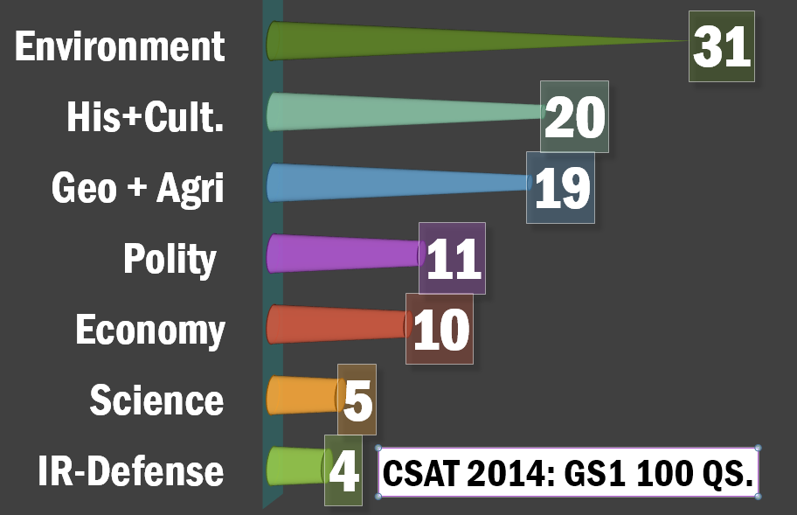
Tough
Agro. Tough
Notes:
Almost equal weightage to all sections except EnB

Slide 6
7/8 Pillars @MCQ stage
Polity
Economy
History
Geography and Agriculture
Environment & Biodiversity
Science
International Relation (CDS, CAPF)
PIN, Awards, Sports (Hardly in UPSC)
Finish’em 1st

Slide 7
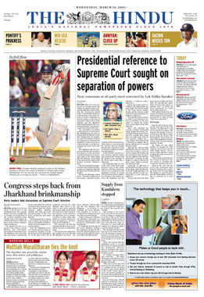
Current Affairs Hindu
National- polity, Development
Economy
Science-Tech
International
South India
Sports, PIN
Notes:
Hard to follow current, if you’ve no theory

Slide 8
RBI reduced Repo rate to 25 basis points.
NEW Player
Seasoned Player
15/1/15
Xyz Bank CMD said ____.
Xyz bank reduced home loan rates ___.
Xyz Expert says _____.
GDP boost
…….
Repo 8% => 7.75% (Jan’15)

Slide 9
Notes making is essential for Mains.
Crispy notes only when “CORE Syllabus” is finished.

Slide 10
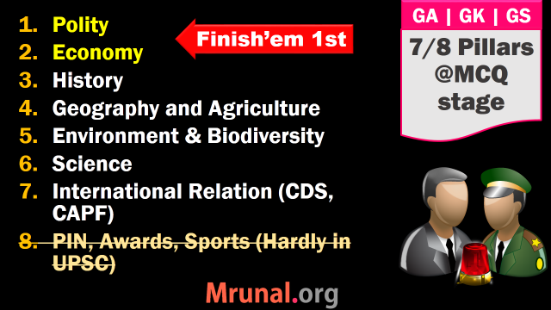

Slide 11
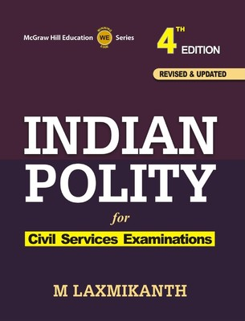
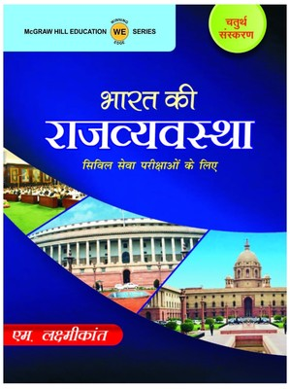
Polity Books DD Basu, Kashyap, MV Paylee
Laxmikanth
9 out 11
Direct in CSAT 2014

Slide 12
Laxmikanth
History, Evolution
Union
States
Bodies
FR-FD, DPSP
PRI, ULB
BEGIN
from
HERE

Slide 13
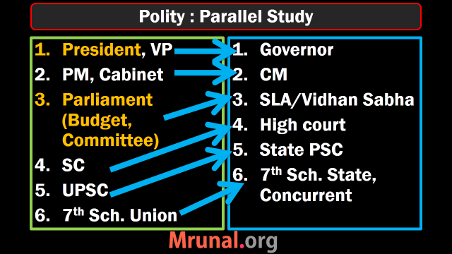

Slide 14
Laxmikanth
History, Evolution
Union
States
Bodies
FR-FD, DPSP
PRI, ULB
Appendix

Slide 15
Remaining Blocks
Polity
FR, FD, DPSP, Alien
Amendment, J&K, 5th & 6th
Local Governance [PRI, ULB]
Bodies: Statutory, Constitutional- str, functions, Person in news

Slide 16
Appendix
Union-State-Concurrent
Table of precedence
Amendment list
Article list (selected)

Slide 17
History at last
Laxmikanth
History, Evolution (freedom struggle)
Union
States
Bodies
FR-FD, DPSP
PRI, ULB
Appendix

Slide 18
CSAT 2014
Q1. Which one of the following is the largest Committee of the Parliament?
The Committee on Public Accounts
The Committee on Estimates
The Committee on Public Undertakings
The Committee on Petitions

Slide 19
Find correct statements
The President shall make rules for the more convenient transaction of the business of the Government of India, and for the allocation among Ministers of the said business.
All executive actions of the Government of India shall be expressed to be taken in the name of the Prime Minister.
Both Correct
None correct

Slide 20
Types of MCQs
2TF, 3TF, 4TF, 5TF (LAXMIKANTH by heart)
Bodies: Appointment, function, jurisdiction
Match the following: years, articles, functions
Person in news (PIN)

Slide 21
UPSC CDS(I)2014: NCERT Political science
Political theory ____.
deals with the ideas and Principles that shape Constitutions
clarifies the meaning of freedom, equality and justice
probes the significance of principles of rule of law, separation of power and judicial review
Correct Statements are:
1 and 2 only
1 only
2 and 3 only
1,2 and 3 (Class11, Page6)

Slide 22
Additional After Laxmikanth
Polity
NCERT Political science, Sociology (Mrunal.org/DOWNLOAD)
India 2015: ch3, 20, 28
MCQs: Laxmikanth, GS Manual, previous papers
Parliament Handbook (ONLY if time permits)
Notes:
Bill= UPSC; Gujarat sites

Slide 23
Static Polity
Qatal ki Subh
~200 days
“GS-Core Syllabus”
Optional Syllabus

Slide 24
Current
Polity
Bills, Act, Ordinance
Rights issues [SC Judgments, Government schemes-policies]
Election [RPA: GS2]
TheHindu => “National”, “Columns”
PrsIndia.org
Mrunal.org/Polity

Slide 26
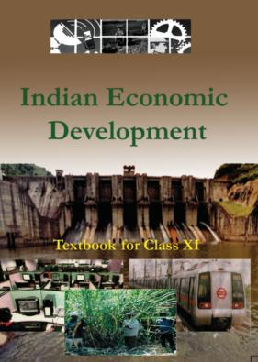
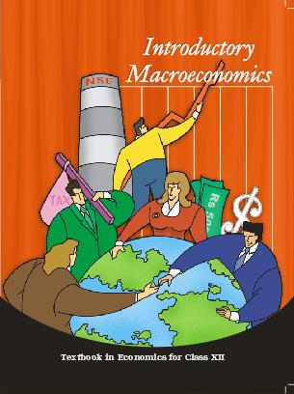
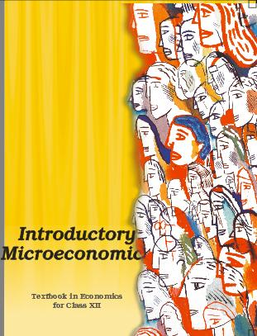
7 Pillars of Economy for UPSC
Pillar #1: Basics of Micro & Macro & Indian Economy
Class11
Types of Economies
LPG reforms
Class12: MACRO
GDP, NNP
National income
Money & banking
Class12- MICRO
Selected only
Mrunal.org/economy

Slide 27
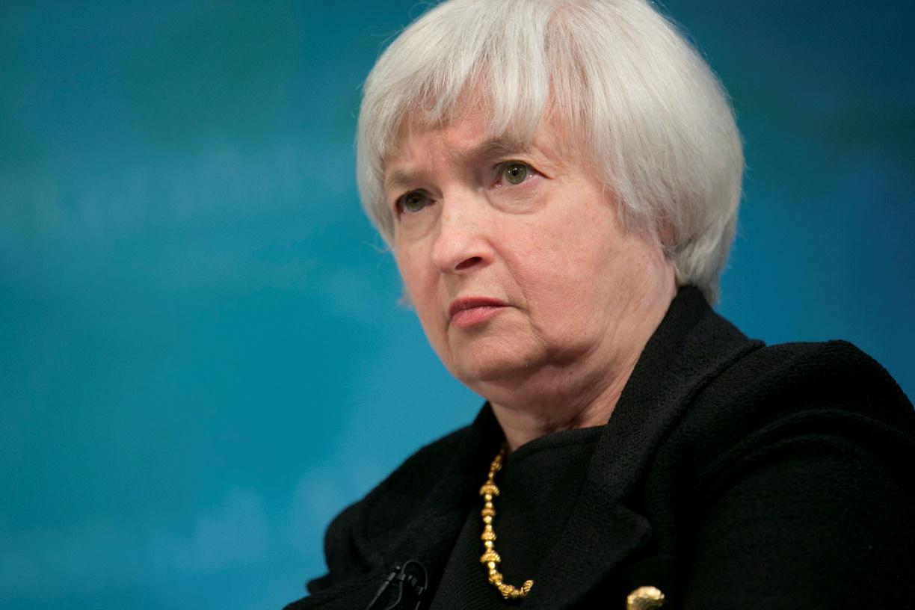
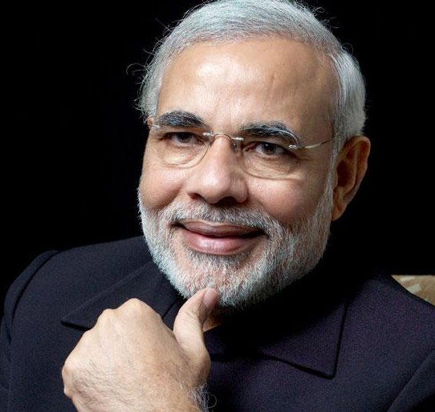
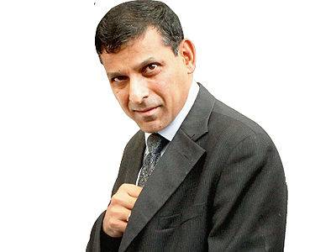
7 Pillars of Economy
2. Banking-Finance
Monetary Policy
Banking Sector
Capital Market
3. Fiscal Policy
Budget, Taxation
Subsidies
Fiscal Deficit
4. International
BoP, CAD
WTO & other Org.
Policies affecting
GS Mains P2
From next lecture

Slide 28
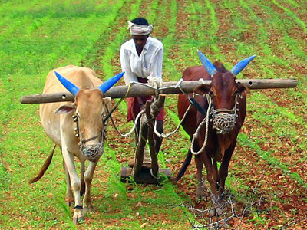

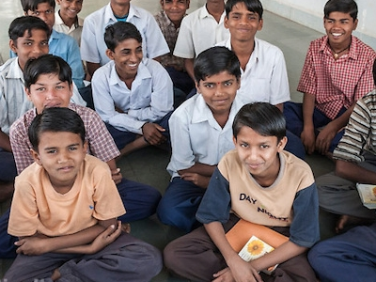
Economic SURVEY
5. Sectors of Economy
Agriculture
MSME, Industries
Service sector
6.Infrastructure
Energy
Transport
RUR-URBAN
7. HRD
Skill Development
Poverty line
Weaker sections

Slide 29
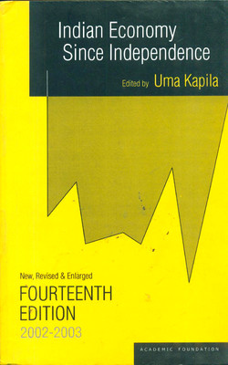
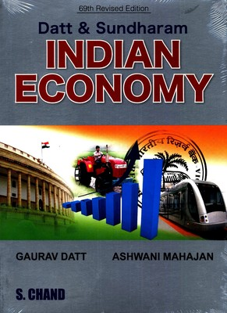
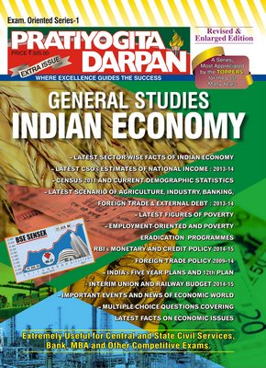
Not Essential for Economy
At max. just selected
Chapters on
Poverty, Development, Public-finance, Subsidies

Slide 30
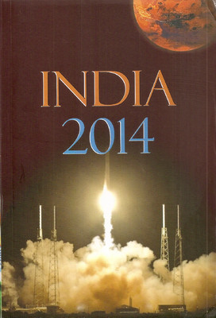
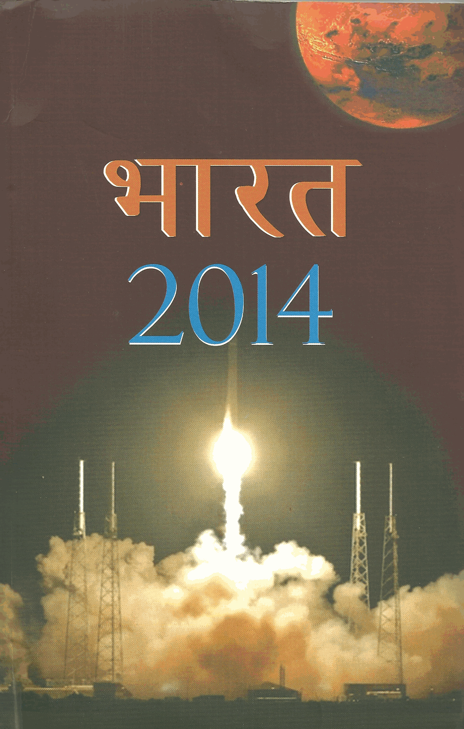
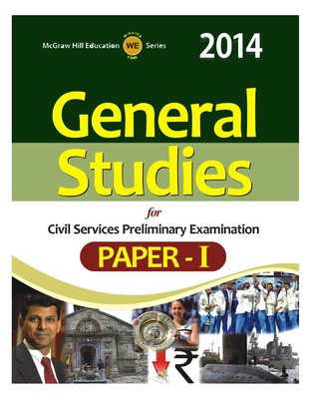

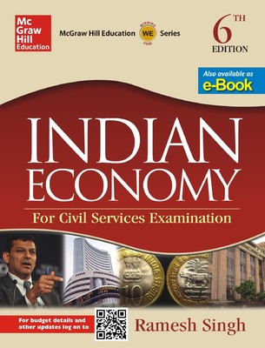
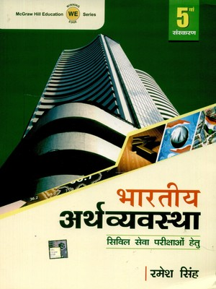
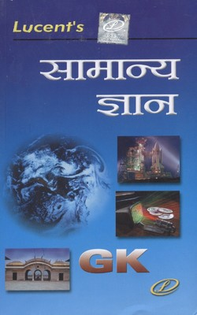

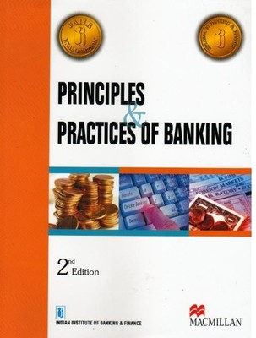
Economy: Dutt Sundaram, Uma Kapila
Wait for 2015
Land reform
Cooperatives
Ashish Notes
Ch.6,7,13,19;21-24
MCQ
1,6,7
Others as per my lectures
Non-UPSC: unnecessary

Slide 31
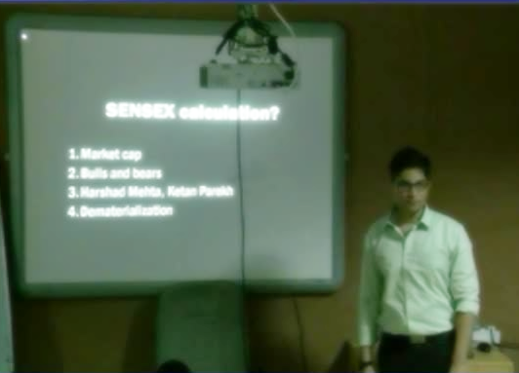
Then what to prepare?
NCERT 11, 12
IYB-2015
Lecture + Mrunal.org
Budget +Survey
TheHindu
10 Questions in CSAT-14
170+ in Mains GS2+3 combined

Slide 32
Static Polity
Economy
Qatal ki Subh
~200 days
“GS-Core Syllabus”
Optional Syllabus

Slide 33
7/8 Pillars @MCQ stage
Polity
Economy
History
Geography and Agriculture
Environment & Biodiversity
Science
International Relation
PIN, Awards, Sports (Hardly in UPSC)

Slide 34
Old NCERT
New NCERT (2007)
Geography (USSR)
Economy (academic)
Science
History:
TN state Books
GS Manual
History (Art, culture, religion)
Geography
Economy (11, 12)
Science
Pol.Sci., Socio

Slide 35
Old NCERT on flipkart.com
Oxford:
RS Sharma: India’s Ancient Past
Orient Blackswan
Satish Chandra: History of Medieval India
Bipan Chandra: History of Modern India
Arjun Dev: History of the World

Slide 36
How to approach History
History
Ancient
Medieval
Modern (Freedom)
World
Post Independence
first
Mains
Notes:
Banks= vocab is interwoven in the passage itself

Slide 37
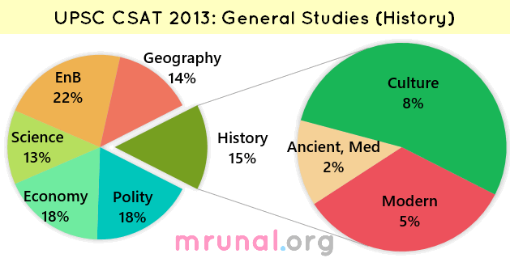
EASY

Slide 38
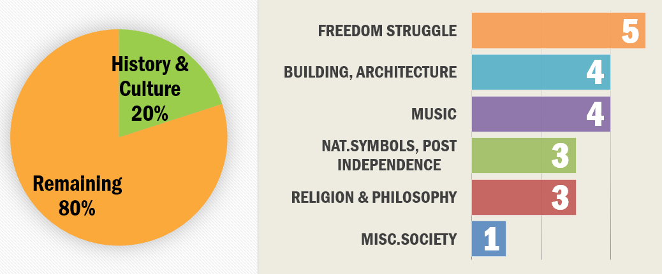
CSAT-2014 General Studies
EASY

Slide 39
How to approach Freedom Struggle
History
Ancient
Medieval
Modern (Freedom)
World
Post Independence
1857
Reformers
Moderate-Extremist
Gandhi
British Reponses
Notes:
Banks= vocab is interwoven in the passage itself

Slide 40
Advent of Europeans
Even before 1857
GG & their contribution
1857 reasons, consequences
Revolts: peasant, Tribal (Mrunal./Polity =>Land reform)

Slide 41
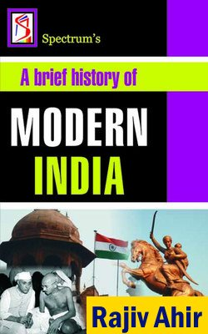

1857: Freedom struggle
Prelim + Mains

Slide 42
1857 & after
1857: causes, events, consequences
Reformers
Org. founders
Newspaper, books
Edu. Commission (Hunter, Sadler..)

Slide 43
How to approach Freedom Struggle
History
CSAT
CAPF, CDS
SSC-CGL
State service
Ancient
Medieval
Modern (Freedom)
World
Post Independence
1857
Reformers
Moderate-Extremist
Gandhi
British Reponses
Notes:
Banks= vocab is interwoven in the passage itself

Slide 44
Modern: Moderates
Congress: GK session, President
Moderate, Extremist, Surat split
Home Rule, Beasant vs Tilak
Swaraj Party, Nehru report
Provincial Ministries vs Muslim League

Slide 45
Modern: Revolution
Leaders
org., newspapers
Gadar-100 years (2013)
Conspiracy cases
INA trial (Netaji Files)
RIN Mutiny (Mains-2014)

Slide 46
How to approach Freedom Struggle
History
CSAT
CAPF, CDS
SSC-CGL
State service
Ancient
Medieval
Modern (Freedom)
World
Post Independence
1857
Reformers
Moderate-Extremist
Gandhi
British Reponses
Notes:
Banks= vocab is interwoven in the passage itself

Slide 47
Gandhi
South Africa (Mrunal /history)
Champaran, A’bad, Kheda;
NCM, Khilafat, CDM, QIM, Partition
Gandhi-Irwin, Gandhi-Amebedkar, Gandhi-Bose
Other freedom fighters (mains)

Slide 48
How to approach Freedom Struggle
History
CSAT
CAPF, CDS
SSC-CGL
State service
Ancient
Medieval
Modern (Freedom)
World
Post Independence
1857
Reformers
Moderate-Extremist
Gandhi
British Reponses
Notes:
Banks= vocab is interwoven in the passage itself

Slide 49
British Response
Reforms: Morley Minto; Montague-Chelmsford
Acts: 1909, 1919, 1935 & 1947; (Laxmikanth)

Slide 50
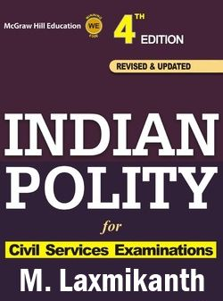
Laxmikanth
History, Evolution (freedom struggle)
Union
States
Bodies
FR-FD, DPSP
PRI, ULB

Slide 51
British Response
Anti-Reforms: Rowlett, Jalliyanwala, Simon, RTC, Communal award
Partition: Linlithgow offer, Wavell plan, Cabinet Mission , Cripps Mission, Mountbatton (Make revision table)

Slide 52
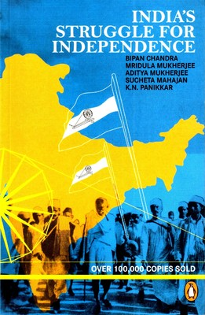
Followup IF TIME LEFT
MCQ
Timeline
Refining
Essay Points

Slide 53
CAPF-2014
Who translated Dinabandhu Mitra’s play “Neel Darpan” into English?
Reverend James Long
Dwarkanath Tagore
Michael Madhusudan Dutta (correct, Pearson)
Rabindranath Tagore

Slide 54
CAPF 2014 (3rd March Hindu)
In March 2014 mortal remains 1857 mutineers were exhumed from a well at ____. These remains are of ____ soldiers.
Choices:
Jallianwala Bagh, 36 Regiment of Sikh Infantry
Lahore, 75 Regular Native Infantry Regiment
Ajnala, 26 Regiment of Bengal Native Infantry
Satti Chaura Ghat, 19 Regiment of Bengal Native Infantry

Slide 55
How to approach History
History
CSAT
CAPF, CDS
SSC-CGL
StatePSC
Ancient
Medieval
Modern (Freedom)
World
Post Independence
Notes:
Banks= vocab is interwoven in the passage itself

Slide 56
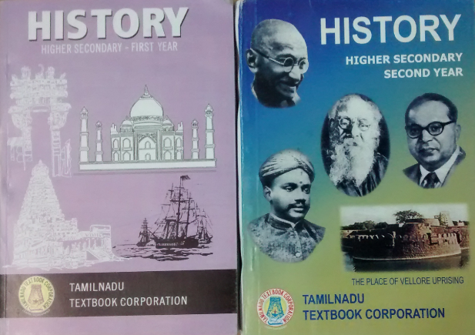
Tamilnadu Class 11 and 12 (/download)
Ancient
Medieval
Freedom struggle
World History

Slide 57
Ancient + Culture
Tamilnadu Class 11 | old NCERT
New NCERT
Lucent GK (Ready revision tables)
General Studies Manual (MCQ)
NIOS Culture (Download)
CCRTindia.gov.in
India Yearbook: Ch2

Slide 58
Ancient: What to prepare?
Harappa
Features
What found where?
Causes of decline
Vedic age basic (Sabha, Samiti, litt.)

Slide 59
Buddism Jainism DETAIL
Pillar doctrine
Sect, kings, travelers
Council
Places, monuments. features

Slide 60
Harappa Vedic Age Jain-Buddhism
3 Mauryan Kings (victories, policies, arch.)
Chandragupta Maurya
Bindusara
Asoka (pillar, messages)
+ Greek Envoys, Foreign Travelers
+ caves, art form, authors
IGNORE: Bimbisara- Ajatshatru, Udayin, Shisunag & Nanda.

Slide 61
Only 3 After Maurya
Pushyamitra
RudraDaman
Kanishka (Buddhism)

Slide 62
Gupta Age & after
Samudragupta & Vikramaditya
Harshavardhan & Huien Tsang (TN)
Pala-Pallav-Pratihar-Rahstrakuta (Culture-Architecture)

Slide 63
South India : Ancient-medieval
(culture) Sangam literature- Manimekalai, Tolkapiyam
Chera-Chola-Pandya: emblem, temples [Rajendra Chola: 1000 years]
Hoysala Architecture
Mrunal.org/history

Slide 64
How to approach History
History
CSAT
CAPF, CDS
SSC-CGL
StatePSC
Ancient
Medieval
Modern (Freedom)
World
Post Independence
2nd
culture
first
Mains
Notes:
Banks= vocab is interwoven in the passage itself

Slide 66
CSAT-2014 General Studies

Slide 67
Medieval
Religion & Architecture
Sufi, bhakti, Sikh
N.India: Kings (Administrative), Poets, Mosques, Tombs, Architecture [ASI restore]
S. India: Vijayangar, Temples, Europeans=> Modern India

Slide 68
CSAT-2013: following Bhakti Saints
Dadu Dayal
Guru Nanak
Tyagaraja
Who among the above was/were preaching when the Lodi dynasty fell & Babur took over?
1 & 3
2 only
2 & 3
1 & 2

Slide 69
CSAT 2014
In medieval India, the designations ‘Mahattara’ and ‘Pattakila’ were used for
military officers
village headmen
specialists in Vedic rituals
chiefs of craft guilds

Slide 70
History: Culture
NIOS (Mrunal.org/download)
CCRtIndia.gov.in [Mrunal/Answerkeys]
TheHindu (ASI restoration, excavation)
Spectrum: Culture

Slide 71
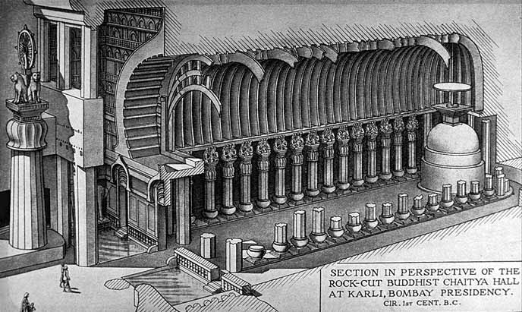
Only 2 caves have such lion pillars in front: Karle & Kanheri
Largest Chaitya-griha
in India
Stupa: Cylindrical Drum shaped
Always google for image
Notes:
Roman Saini

Slide 72
How to approach History
History
CSAT
CAPF, CDS
SSC-CGL
StatePSC
Ancient
Medieval
Modern (Freedom)
World
Post Independence
2nd
culture
first
Mains
Notes:
Banks= vocab is interwoven in the passage itself

Slide 73

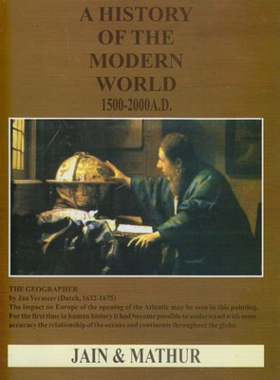
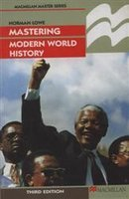
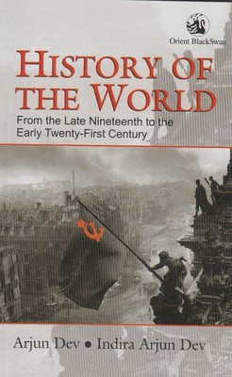
History : Mains GS1 (Post independence + world)
Bipan
Jain
Norman Lowe
Arjun Dev
Mrunal.org/history
Notes:
Mains-2014 World History rather too easy.

Slide 74
Static Polity
Economy
History
Qatal ki Subh
~200 days
Topic wise Mock Tests

Slide 75
3 / 6 Pillars
Polity
Economy
History
Geography
Environment Biodiversity
Science (SSC, CDS, CAPF)
International Relation (CDS, CAPF)
PIN, Awards, Sports (Hardly in UPSC)

Slide 76
How to approach Geography
Geography
UPSC
CAPF, CDS
SSC-CGL
StatePSC
Physical
World
Indian
Agro.
Environment
Notes:
Banks= vocab is interwoven in the passage itself

Slide 77
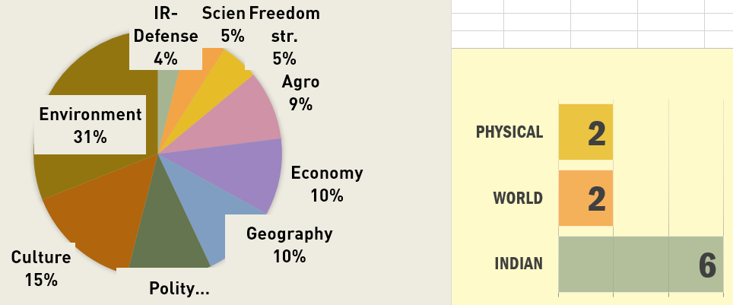
CSAT 2014: 4 / 10 directly from NCERT

Slide 78
Physical Geography (NCERT)
Universe | Science Class 8 Ch.17 Geography Class 6 Ch.1 Geography Class 11 Ch 2.
Earth Basics | Geography Class 6 Ch.2 to 6 Geography Class 11 Ch.1, 3 & 4
Geology | Geography Class 11 Ch.5 to 7
climate | Geography Class 11 Ch.8 to 12
Ocean | Geography Class 11 Ch.13 & 14
Disaster | Geography Class 11 (Indian Geography) Ch.7 Science Class7 ch8 Science Class 8 ch15
Misc. | Geography Class 11 Ch.1 & glossary
After NCERT is done | Goh Che Leong’s Certificate Physical & Human Geography book OR General Studies Manual Spectrum

Slide 79
World Geography
NCERT Class | Chapter
7 | 7 to 10
8 | 1,3,5,6
12 (Human Geography) | 1 to 10

Slide 80
World Geography: focus?
Mountain range in each continent & highest peak
longest, largest rivers: countries covered by them
fresh water lakes; water falls : countries they belong to (just top 3-5 names)
cold & hot deserts of the world: countries covered by them
landlocked countries in Europe & Asia
Location of famous grassland (Veld, Prairies, Pampas etc.), tribes (Pigmy, Masai etc.) & winds.
famous borders (e.g. Durand line, 38th parallel etc)

Slide 81
World Geography: What to focus?
Capitals of Middle East, European & South East Asian countries
famous cities-their nick names/specialty; on which river they’re located
famous monuments / heritage sites (Angkor Wat, Machu Pichu etc)
famous strait & which sea do they join (e.g Palk, Berring, Gibralter etc)
Places in current affairs: Ukrain, Crimea, South China sea, Gwadar port

Slide 82
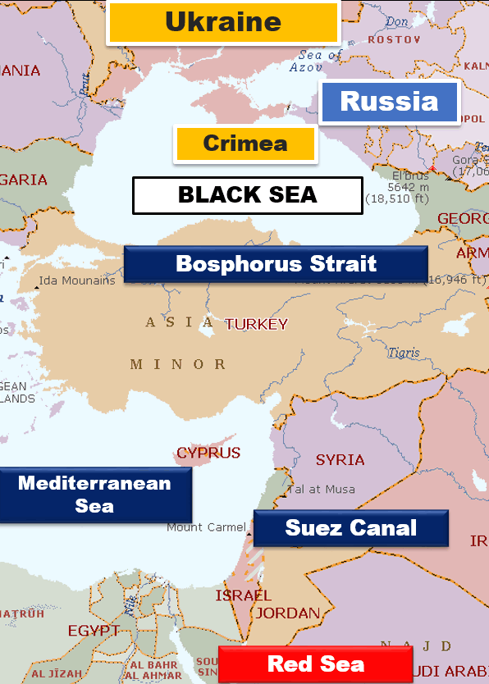

Slide 83
Indian Geography
topic | class | chapters
India basic | 6 | 7
 | 9 | 1, 2, 4
 | 11 | 1 & 2
rivers | 9 | 3
 | 10 | 3
 | 11 | 3
 | 12 | 6
Economic geography | 10 | 1,5, 6, 7
 | 12 | 7 to 12
Human Geography | 9 | 6
 | 12 | 1 to 4
After NCERT is done | Spectrum Geography OR Lucent’s GK Book DR Khullar’s India: A comprehensive Geography OR General Studies Manual OR

Slide 84

Indian geography
Geography
simultaneously refer Oxford School atlas
mountains, mountain passes, rivers, borders, corridors
weather, cropping pattern
sanctuaries, national parks
Minute GK,
Mineral ranking

Slide 85
How to approach Geography
Geography
UPSC
CAPF, CDS
SSC-CGL
StatePSC
Physical
World
Indian
Agro.
Environment
Notes:
Banks= vocab is interwoven in the passage itself

Slide 86
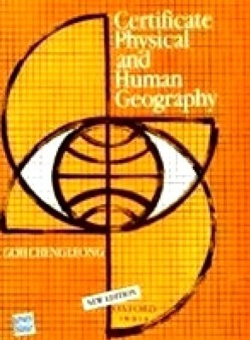
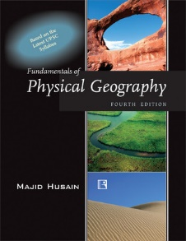
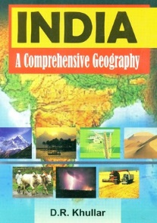
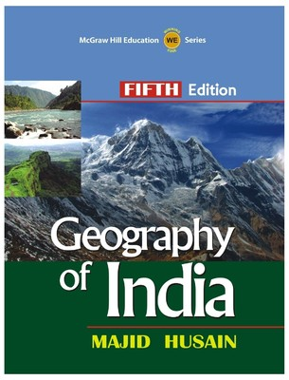
books
Physical
CDS/CAPF
India

Slide 87
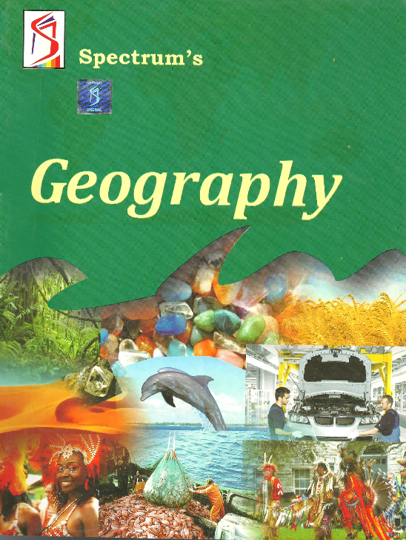

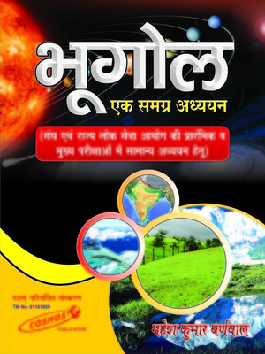
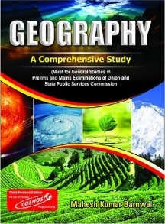
Geography (All in one)
Spectrum
UPSC: Prelim + Mains
Mahesh Barnwal
State Service

Slide 88
Static Polity
Economy
Geography, History
Qatal ki Subh
~200 days
Topic wise Mock Tests

Slide 89
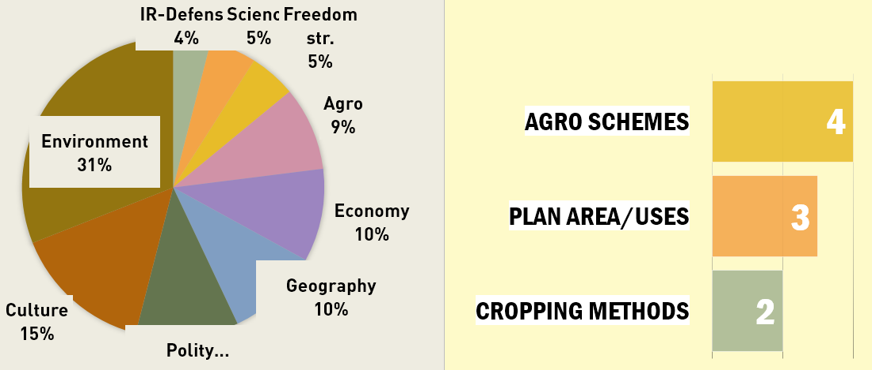
CSAT 2014: Agro. Mostly tough ,out of book

Slide 90
Agriculture
NCERT class | subject | chapters
7 | science | 3 & 9
8 | geography | 4
 | science | 1
9 | science | 15
11 | geography (India) | 6
12 | geography (Human) | 5
 | geography (India land & people) | 5
After NCERT | Soil related chapter from Spectrum OR Majid Hussain or DR Khullar’s book.

Slide 91
How to approach Environment
Geography
UPSC
CAPF, CDS
SSC-CGL
StatePSC
Physical
World
Indian
Agro.
Environment
Notes:
Banks= vocab is interwoven in the passage itself

Slide 92
How to approach Environment
Geography
Physical
World
Indian
Agro.
Environment
Theory
Contemporary
Current
Notes:
Banks= vocab is interwoven in the passage itself

Slide 93
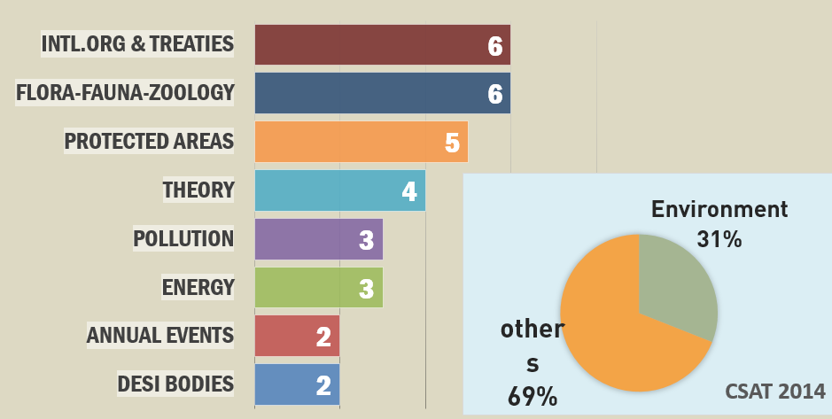
CSAT 2014 answerkey: Mrunal.org/UPSC

Slide 94
NCERT: environment
CLASS | SUBJECT | CHAPTERS
6 | geography | 8
7 | geo. | 1 to 6
 | science | 7, 16 to 18
8 | geo. | 8
 | sci. | 7 & 18
9 | geo | 5
 | science | 14
10 | Geo. | 2
 | sci. | 14 to 16
11 | geo(Physical) | 15 & 16
 | geo (India) | 4 & 5
 | economy | 9 (Sustainable development)
12 | Biology | 13 to 16
 | chemistry | 14

Slide 95

Reference
Shankar’s Book
NIOS
Mrunal=> environment section
India 2015: Ch.1, 11, 12, 25
TheHindu

Slide 96
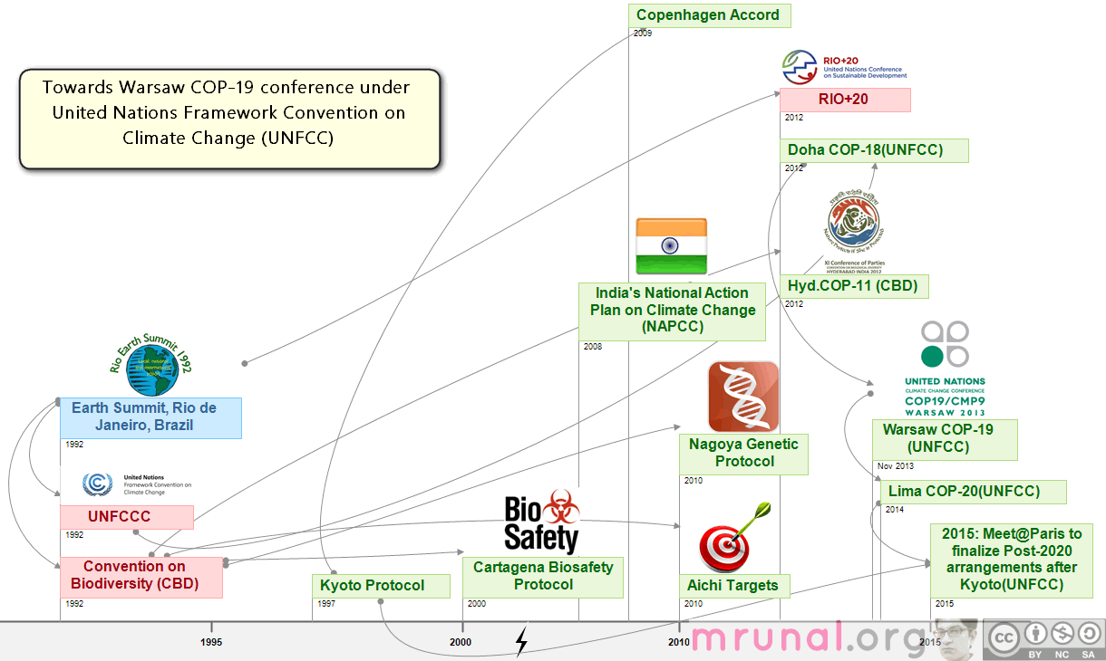
Treaties & summits

Slide 97

Mrunal.org
Environment
Treaty-summits
Definition, concepts e.g. biomagnification, algae bloom
Species: location, critically endangered
Pollution related
Clean Energy

Slide 98
How to approach Environment
Geography
UPSC
CAPF, CDS
SSC-CGL
StatePSC
Physical
World
Indian
Agro.
Environment
first
last
first
first
first
Notes:
Banks= vocab is interwoven in the passage itself

Slide 99
Static Polity
Economy
Qatal ki Subh
~200 days
Geography, History, Environment
Topic wise Mock Tests

Slide 100
Last Pillar
Polity
Economy
History
Geography
Environment Biodiversity
Science (SSC, CDS, CAPF)
International Relation (CDS, CAPF)
PIN, Awards, Sports (Hardly in UPSC)

Slide 101

CSAT 2014: 4/5 easy: NCERT, GSM,Lucent

Slide 102
NCERT Science-irrespective of degree
Class | PHYSICS | Chemistry | Biology
7 | 4, 13, 14 & 15 | 5 & 6 | 1,2,10; 11 & 12
8 | 11 to 16 | 3 to 6 | 2, 8, 9 & 10
9 | 8 to 12 | 1 to 4 | 5,6,7 & 13
10 | 10, 12 & 13 | 1 to 5 | 6 to 11
11 | 1,5,8 | 1,14 | 2 to 5
12 | 15 | 14,16 | 4,5 then 7 to 16
Environment related
Psychology Ch4, Glossary

Slide 103
CDS 2014 (1)
People suffering from anorexia nervosa
Develop paralysis
Show poor reflex
Cannot speak properly
Eat very little and fear gaining weight
NCERT 12 Psychology Ch.4 Page 16 +Glossary
Lucent/GS Manual

Slide 104
CDS 2014(i)
Bone weakening is caused by Deficiency of ___.
Calcium
Phosphorus
Nitrogen
Carbon
Answer choices
1 and 2 only
1 only
1, 2 and 3
4 only

Slide 105
CDS 2014(i)
Deficiency of ___ is/are responsible for weakening of bones?
Calcium
Phosphorus
Nitrogen
Carbon
1 and 2 only
1 only
1, 2 and 3
4
NCERT Class 9 Ch6 Page 9

Slide 106
NCERT Science: Irrespective of Degree
Class | PHYSICS | Chemistry | Biology
7 | 4, 13, 14 & 15 | 5 & 6 | 1,2,10; 11 & 12
8 | 11 to 16 | 3 to 6 | 2, 8, 9 & 10
9 | 8 to 12 | 1 to 4 | 5,6,7 & 13
10 | 10, 12 & 13 | 1 to 5 | 6 to 11
11 | 1,5,8 | 1,14 | 2 to 5
12 | 15 | 14,16 | 4,5 then 7 to 16

Slide 107
After NCERT
Science
GS Manual : Physics – real life examples, chemical uses, disease tables, MCQ practice;
Lucent GK: disease table, nutrient uses

Slide 108
Current Affairs
Science Tech
Space (Mangalyan, GSLV)
nanotech
Medical- ebola, malnutrition
clean energy
Information Technology
TheHindu: Thursday edition: but Hardly anything in prelim/Mains
Mrunal.org

Slide 109
Static Polity
Economy
Theory: Geography, History, Environment, Science
Qatal ki Subh
~200 days
Topic wise Mock Tests

Slide 110


Mrunal.org/UPSC

Slide 111
Mrunal.org /PIN
Polity
Economy
History
Geography
Environment Biodiversity
Science (SSC, CDS, CAPF)
International Relation (summit-theme (/PIN, /diplomacy)
Notes:
Q1: IR- Arab Spring
Q2: IR- BRICS summits
Q3: IR- Regions in News
Q4: Defense- Agni-IV

Slide 112
NEXT
Notes making
Newspapers, magazines
Time management
Career backups

